Slide 1
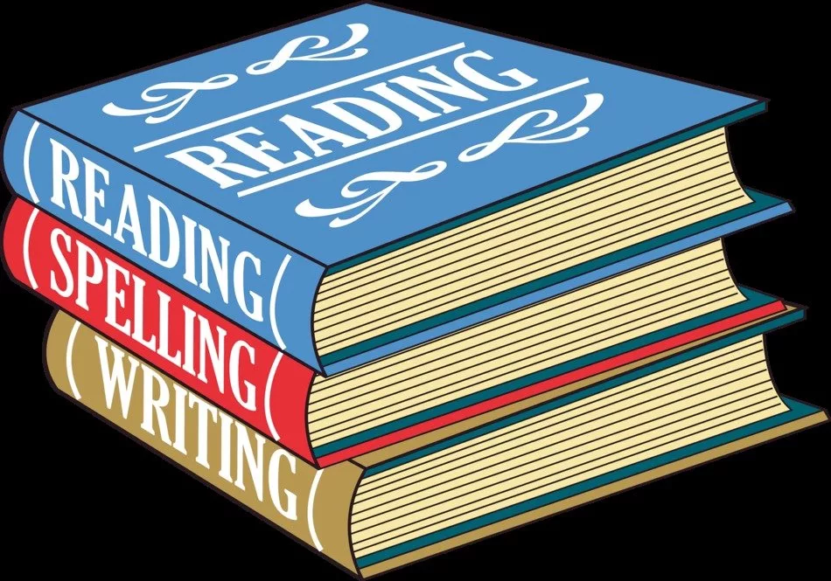

Slide 2
1 – skimming
Reading for the gist or the main idea of the text
4 extensive reading
Reading for pleasure and comprehension
2 – scanning
Reading to fins specific information
Types of Reading
3 – intensive reading
Reading for getting the details

Slide 3
SKIM When you want to read something quickly to get general idea | SCAN When you want to read something quickly to get a specific piece of information.
Skim when you previewing a book for selection. | Scan when you have a question that you need answere.
Skim when you are rereading some pages before moving on in a book. | Scan when you are trying to find a phone number, looking in a dictionary, or searching through an index.
Skim when you are looking through a newspaper or magazine.
Move your eyes quickly over the page to get the information you need.

Slide 4
SKIM | SCAN
Don’t read everything but trying to skip the text. | Look at the question and try identify what is asked for in it.
Read the first and the second of paragraphs. | Look for the key words related to your topic.
Read heading and subheadings. | Look for the digits like numbers and dates or specific words.
Read the introduction and the summary. | Look for bold print or italics.
Read the table of contents. | Look for words in a larger font sizes.
Look at any illustrations or graphic features. | Look for the bulleted information or sidebars.
Read a few examples before you understand the consept they are meant to illustrate. | It is important to understand how your material is structured as well as comprehend what you read so you can locate specific the information you need.

Slide 5

INTENSIVE READING reading for academic purposes which is used mostly in class | Extensive reading reading for research work or pleasur
100%understanding | Overall understanding (gist)
Limited reading | Widespread reading
Difficult texts | Easy texts
Word for word | Fluent reading
Use dictionaries | Infer the meaning of unknown words
Reading to create and analyze meaning | Reading for pleasure

Slide 6

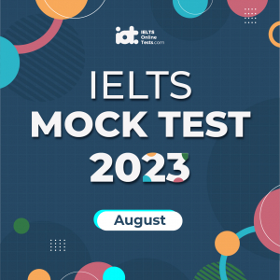

LISTENING COMPREHENSION is part of the communication skills such as
the development of reading and writing comprehension. Listening Comprehension has the multiple processes of comprehension in language when it is understood, interpreted and spoken.
LISTENING
Discover your current English level
by taking our free online test
IELTS Mock Test 2023 August
FILMS FOR LEARNING ENGLISH
https://learnenglish.britishcouncil.org/skills/listening
https://myenglishworld.pro/blog/filmyi-dlya-izucheniya-angliyskogo/#article
https://ieltsonlinetests.com/

Slide 7


